Slide 1
Uncertainty Quantification
with Rappture
Derrick Kearney
HUBzero® Platform for Scientific Collaboration
Purdue University
With info and images from Martin Hunt
This work licensed under
Creative Commons
See license online:
by-nc-sa/3.0

Slide 2

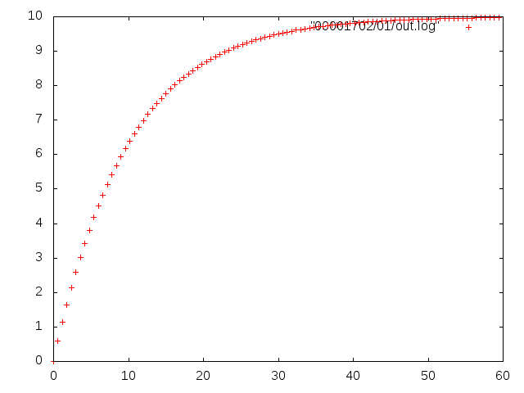
Exact values only
Vin = 10V
R = 100KOhm
C = 100uF
T = [0,60]s

Slide 3
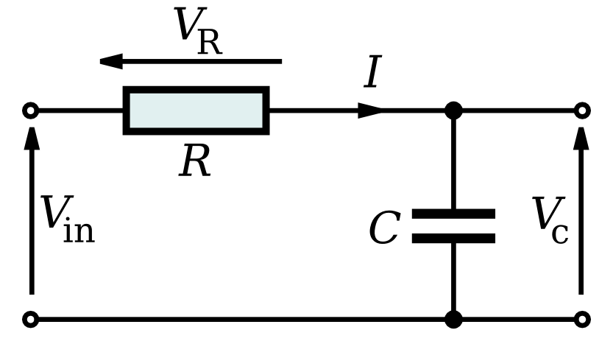
1 0 0 100K 5%
Rappture

Slide 4
Simulating with exact values
driver1827.xml
Vin = 10V
R = 100KOhm
C = 100uF
t = [0,60]s
<XML>
Your
Model
<XML>
run12703129102.xml

Slide 5
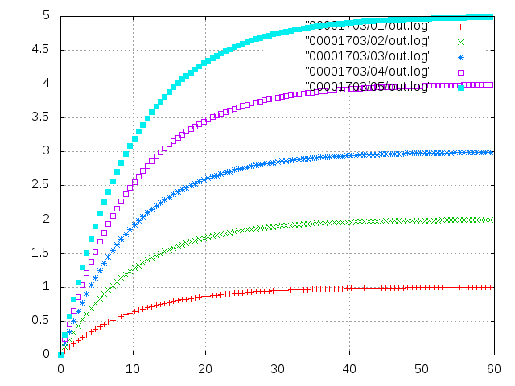
Simulating with uncertain values
driver1827.xml
Vin = 10V
R = 100KOhm±5%
C = 100uF
t = [0,60]s
<XML>
Your
Model
1 0 0 100K 5%
<XML>
run12703129102.xml

Slide 6
Uncertainty Quantification

Slide 7
PUQ provides UQ inside Rappture

Slide 8
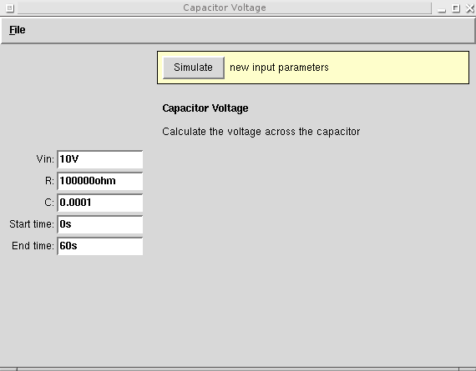
Rappture tools without UQ
<?xml version="1.0"?>
<run>
…
<tool>
<title>Capacitor Voltage</title>
<about>Calculate … </about>
<command> … </command>
</tool>
...
</run>
<XML>
tool.xml

Slide 9
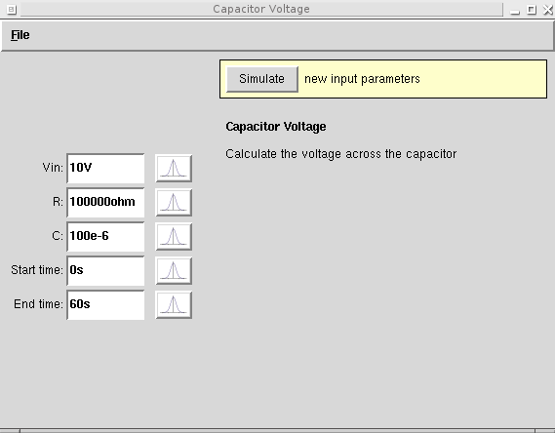

Adding UQ to a Rappture tool
<?xml version="1.0"?>
<run>
…
<tool>
<title>Capacitor Voltage</title>
<about>Calculate … </about>
<command> … </command>
<uq>true</uq>
</tool>
...
</run>
<XML>
tool.xml

Slide 10
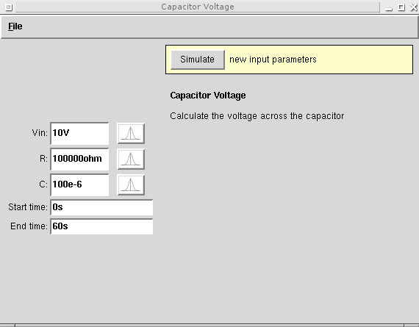
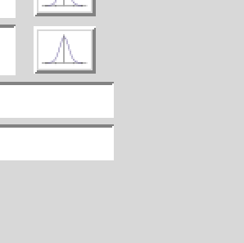
Disabling UQ for controls
<?xml version="1.0"?>
<run>
…
<number>
<about>
<label>Start time</label>
</about>
<default>0s</default>
<uq>false</uq>
</number>
...
</run>
<XML>
tool.xml

Slide 11
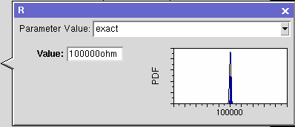
User chooses input type

Slide 12
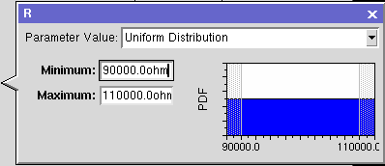
User chooses input type

Slide 13
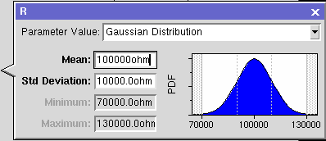
User chooses input type

Slide 14
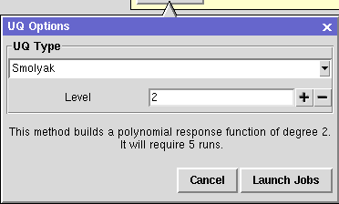

Confirm UQ Jobs

Slide 15
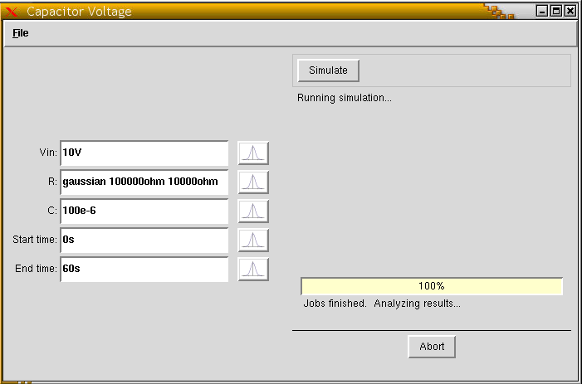
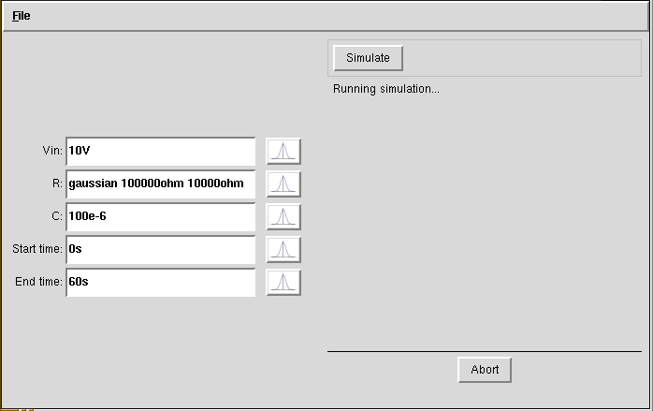
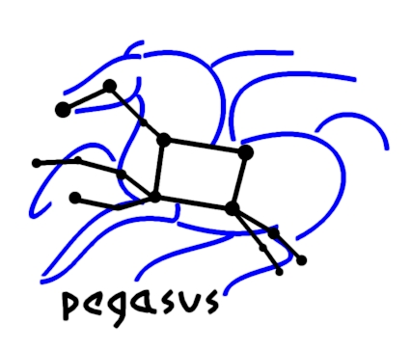


Rappture launches jobs
driver1827.xml
<XML>
PUQ
Submit
Proxy
Rappture
Rappture
Rappture

Slide 16
Rappture correlates the results
run127...102.xml
<XML>
PUQ
Submit
Proxy
<XML>
<XML>
<XML>

Slide 17
UQ Outputs - Numbers
run127...102.xml
<XML>
PUQ
Submit
Proxy
<XML>
<XML>
<XML>

